Slide 2
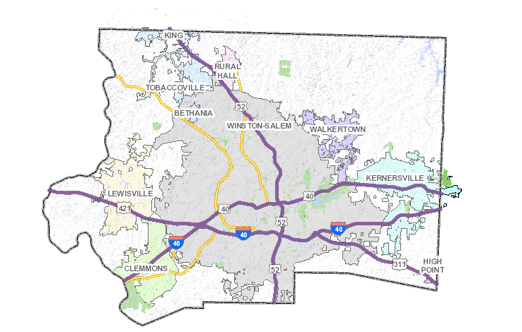

Slide 3
Hospital Name
Your Hospital
Edited 10/10/16

