Slide 1
SUSTAIN STEMI Accelerator
SUSTAIN: Post-Discharge Care 101
3 Core Components get you to GOAL!

Slide 2
Core Components in SUSTAIN Accelerator 2 Post-discharge Demonstration Project
OPERATIONS
1. Forms, Trackers, IRB letter
TRAINING TOOLS
Teach-back
Call-back
Come-back
Touch-back @ 12 months
Notes:
Three evidence-based key components shown to improve post d/c outcomes:
1, 2,3

Slide 3
Summary Score: The Post-Discharge “EKG”
7-Day Visit
Community Health
48 Hour Call
Discharge Plan
Patient Goal & Capacities

Slide 4
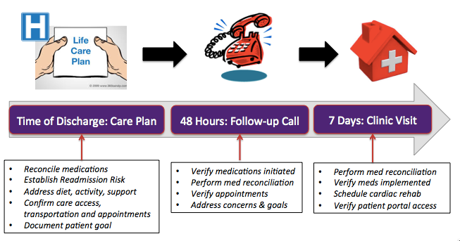
Core Components in SUSTAIN: Teach-back; Call-back; Come-back
Notes:
For accelerator, these components look like this… (call me if you want any info on the content of these boxes!!)

Slide 5
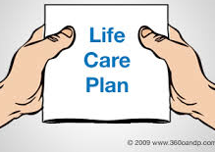
SUSTAIN Quality Intervention: Care Plan at Discharge using Teach-Back
Document skills:
Medication management
Diet management
Activity progression-Cardiac Rehab
Transportation to f/u appointment
Symptom recognition
Community partners mapping

Slide 6
Menu for Teach-Back in SUSTAIN Accelerator Teach-Back Component
Tools for training nurses and community partners
Teach-Back Training Tools (AHRQ )
Tools for patients’ safe medication management
Medication Discrepancy Tool (MDT)
Medications at Transition (MATCH Tool - AHRQ)
Script Your Future™
Meducation©
ManagingYourMeds©
D⁻3 Pillbox©
Portion Plate
There and Home Again (AMA Safe Transitions)
Re-Engineering Discharge (RED) Tool
Notes:
This is our toolikit.

Slide 7
TEACH BACK Training Tool
AHRQ - Health Literacy Universal Precautions Toolkit
http://www.ahrq.gov/professionals/quality-patient-safety/quality-resources/tools/literacy-toolkit/healthlittoolkit2-tool5.html
The Teach-Back Method
A communication confirmation method
Used to confirm whether a patient (or care takers) understands what is being explained to them.
If a patient understands, they are able to "teach-back" the information accurately.
This is a communication method intended to improve health literacy.

Slide 8
Medication Discrepancy Tool (MDT)
www.caretransitions.org
Patient-Level Discrepancies
Adverse drug reaction
Intolerance
No fill of prescription
Patient feels not needed
Financial barriers
Intentional non-adherence
Non-intentional non-adh
Skills/performance deficit
System-Level Discrepancies
Known allergy/intolerance
D/C instructions illegible, incomplete, inaccurate
Duplicate drug
Incorrect drug, dose, or #
Unrecognized need for:
Cognitive facilitator
Caregiver assistance
Sight / dexterity limitation
Coleman, et al., 2008 rev.

Slide 9
Medication Discrepancy Tool (MDT)
www.caretransitions.org
Resolution Categories:
Contacted PCP to clarify med regimen
Discussed consequences of non-adherence
Provided resources and information for adherence
Addressed knowledge or skills for med adherence
Encouraged patient to contact PCP
PCP will address at the next visit
Encouraged patient to schedule appt with PCP
Other______
Coleman, E. 2008

Slide 10
Medications at Transitions and Clinical Handoffs (MATCH) Tool
http://www.ahrq.gov/professionals/quality-patient-safety/patient-safety-resources/resources/match/matchap.html
Process maps for development of team-based quality improvement for medication reconciliation
Patient involvement encouraged
Emphasize EHR as “One Source of Truth”
Single medication list
Accessible to all disciplines / systems
Electronic format recommended for implementation

Slide 11
Patient Sites and Resources in SUSTAIN: Medications, Monitoring Activity, Communication
Resources and Links for Patients and Providers:
Polyglot Medication Education Program
https://meducation.net
National Consumers League Medication Program
www.scriptyourfuture.org/
The Duke Medication Adherence Alliance
http://managingyourmeds.org
Notes:
These outpatient settings (home, cardiac rehab facilities, and the patient health portal to EHR) these are the opportunities to capture data for the “missing middle” of medicaiton adherence that is shown to improve outcomes, improve quality of care, and improve patient satisfaction with care.

Slide 12
The Drag & Drop Pillbox: Patient-Centered, Skill-Based Medication Management
http://pillbox.medapptech.com
Notes:
I think you know the rest!!!

Slide 13
Effective Components of Successful Medication Management Programs
www.ipro.org/index/ct-tools-intervention-resources
Verify drug, dose, frequency
Clarify patient understanding of med list
Document changes, additions, deletions
Oversight of care transition by single role
Use common tool across settings

Slide 14
www.portionplate.com

Slide 15
AMA Safe Transitions Toolkit “There and Home Again, Safely”
http://www.ama-assn.org/go/ambulatorysafety
Five responsibilities for providers:
Conduct comprehensive health assessment
Establish care goals with patient
Support patient self-management
Promote safe and effective medication use
Coordinate care with all members of healthcare team
Tools to ensure safe transition from inpatient to ambulatory settings
Notes:
SHARED GOALS DOCUMENTATION?
AT-HOME SUPPORT FOR SELF-MANAGEMENT?
How to “PROMOTE” EFFECTIVE MED USE?
FEASIBILITY ACROSS HEALTH SYSTEM?

Slide 16
Re-Engineering Discharge (RED) Person-Centered Care = Partnership
http://www.ahrq.gov/professionals/systems/hospital/red/toolkit/index.html
Person-centered care solutions:
Documents the Patient Goal in the EHR
Engages the person as an active partner in care and treatment planning
Highlights the importance of shared goals, and shared responsibility for achieving health goals
Achieves ”What do patients WANT?”

Slide 17
SUSTAIN Quality Intervention: 48 Hr Follow Up Call
SUSTAIN: Call-back component
Tools for Patient Engagement
Meaningful association of medication in context of recurrent symptoms
Facilitation of the association of medication-taking with symptom recognition and symptom-triggers.
Coaching used to develop recognition of symptoms and association to medications
SUSTAIN: Call-back component at 48 Hours

Slide 18
Menu for Call-Back in SUSTAIN Accelerator Call-Back Component
Tools for CALL-BACK
Address key points using AHRQ-integrated scripts
Link the CALL-BACK to a Teach-Back training program
Integrate mentoring for instructors
Include at least ONE tool to review medications
e.g., D³ Pillbox, Meducation, Script Your Future
Document data capture for reporting
Notes:
This is our toolikit.

Slide 19
AHRQ Follow Up Call Toolkit
AHRQ Follow Up Call Toolkit:
http://www.ahrq.gov/professionals/systems/hospital/red/toolkit/redtool5.html
Re-Engineered Discharge (RED) Toolkit
How to conduct a postdischarge followup call:

Slide 20
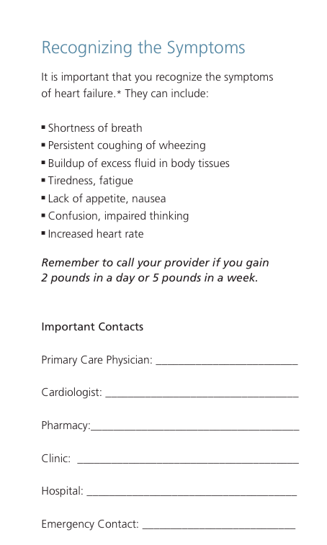
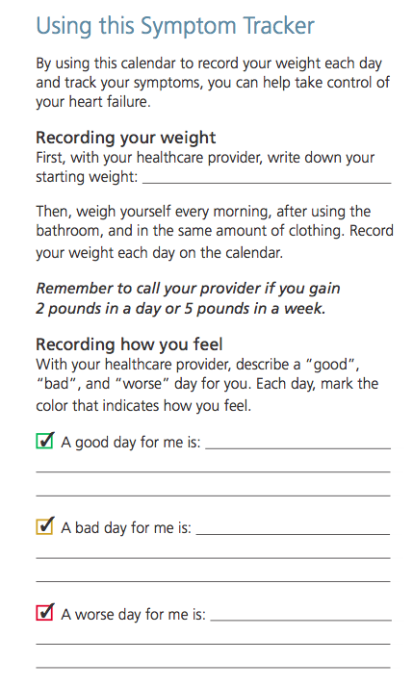
SUSTAIN Quality Intervention: 7 Day Clinic Visit
SUSTAIN: Come back component
3. Clinic-community-coordinated
Person-centered symptom recognition and response plan
Caregiver and provider specific contact information
Tool – Resource List
Personalized symptom triggers, response plan
Provider contacts, pharmacy numbers and appointments
Symptom response tracker
Calendar, Community Events

Slide 21
Menu for Come-Back in SUSTAIN Accelerator Come-Back (In-Person Visits) Component
Tools for readmission risk assessment
BOOST, RED, LACE, Others
Tools for safe medication management
D³ Pillbox, Meducation, Script Your Future
Digital data capture and reporting
Phone Follow-Up, D³ Pillbox Reporting, Registry
Feedback PRIOR to appointments – closes loop

Slide 22
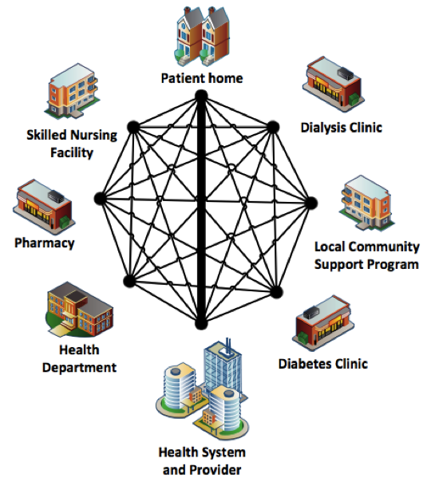
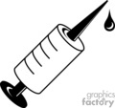
Mapping what happens after discharge Post-Discharge STEMI Systems
EMS
Walk-out
EMS
Walk-in
EMS
Non-PCI
Transfer for pPCI Center
Thrombolytic Treatment
Non-PCI
Thrombolytic Center
pPCI Treatment
EMS
Walk-in
AirMed
Transfers
Direct Presenters
PCI Heart Center
Notes:
Unlike the pre-hospital phase of STEMI care, the plan of care for patient following discharge remains very individualized;
No coordinated systems approaches for care following discharge (neither for actual care delivery OR expectations for providers or patients of resources, support, or feedback on outcomes)
No infrastructure to support the guidelines (unlike pre-hospital phase, which has been dramatically improved after 2004 guidelines and door to balloon ACC alliance in 2006; Race Cars 2008 and Accelerator 1)

Slide 23
Added Value in SUSTAIN: Medications, Monitoring Activity, Communication
Cardiac Rehabilitation
Pre-Clinic Info
Tele-monitoring
STOP Smoking
Sustain Medications
Sustain Activity
Sustain Communication
Notes:
These outpatient settings (home, cardiac rehab facilities, and the patient health portal to EHR) these are the opportunities to capture data for the “missing middle” of medicaiton adherence that is shown to improve outcomes, improve quality of care, and improve patient satisfaction with care.

Slide 24
SUSTAIN: Touch Back at 11 months
Medications, Monitoring Activity, Communication
Safe care in transition to home:
Effective medications for sustained outcome
Effective patient engagement in care plan
Effective communication
Coordination across care team
Clinic-based follow up strategies at home

Slide 25
Summary Score: The Post-Discharge “EKG”
7-Day Visit
Community Health
48 Hour Call
Discharge Plan
Patient Goal & Capacities

