Slide 1
Module 6 Part 3 Choosing the Correct Type of Control Chart Limits
Adapted from:
The Institute for Healthcare Improvement (IHI), the Agency for Healthcare Research and Quality (AHRQ), and the Health Resources and Services Administration (HRSA) Quality Toolkits

Slide 2
Objectives
Identify types of control charts and indications for each
Discuss data-dependent differences in use of control charts:
Attribute data
Classification (categorical)
Count (nominal)
Continuous data
Variable (ratio, interval)

Slide 3
Understanding system stability provides a roadmap for QI design and tool selection
Select a Key Measure Related to the Aim
Develop Appropriate Shewhart Chart
2. Select Chart Type
Type of data = Type of chart
P, C, U, G, T, I, X-bar(S)
Assess baseline data / graphics
Get 12 points (trial) or 20
Set median / control limits
Assess subgroup variability
Assess histogram
1. Assess Data for Key Measure
Type of data (level of measure)
Subgroup size & variability
Metric used (rate or %)
Time interval
Is the System Stable?
Identify Common Cause
Fluctuation cause is unknown
Steady but random distribution around the mean
A measure of process potential; how well process can perform if special cause is removed
Tools / Methods:
Planned experiment
Rational subgrouping
YES
NO
Identify Special Cause
Data points outside control limits
In zones A, B or C (>3 SD of M)
Tools / Methods:
Shewhart charts
Cause-Effect diagram
Planned experiment
Rational subgrouping

Slide 4
Traditional Data Types
Improvement Data Types
Data Type | Description | Example
Nominal | Non-numeric; distinct groups; categories | Male or Female; Ethnicity
Ordinal | Ranked on a scale; Ordered highest to lowest or vice versa | Hospital Rankings; Pain Scales; Patient Satisfaction
Interval | Measured on a scale with consistent, equal distance between values. No absolute zero; cannot calculate ratios (can only + and - ) | Hospital Census, Volume of Blood, Number of Rehospitalizations
Ratio | Measured on a scale with equal distance between values AND an absolute zero; CAN calculate ratios (+, -, x and ÷ ) | Height, weight, blood sugar, temperature
CLASSIFICATION OR “ATTRIBUTE” DATA
CONTINUOUS OR VARIABLE DATA

Slide 5
Type of Data
Continuous
(Variable)
Count/Class
(Attribute)
Subgroup = 1
Subgroup > 1
Class
Count
= area opportunity
≠ area opportunity
= or ≠ subgroup size
Subgroup n=1
Subgroup n>1
X and S Chart
I Chart
P Chart
C Chart
U Chart
# of
Nonconformities
Nonconformities
per Unit
%
Nonconforming
Individual
Measurement
Average and
Standard Dev.

Slide 6
Types of Control Charts
Charts | Definition and Rationale
C | Attribute data, count (whole number) Equal area of opportunity, the subgroup remains constant in every interval of time
U | Attribute data, count (whole number) Equal or unequal area of opportunity, the subgroup size can vary or not
P | Attribute data, classifications using categories Equal or unequal area of opportunity, the subgroup size can vary or not
I | Continuous data, single data value for each subgroup Subgroup size is one
X-S | Continuous data, subgroups have more than one data value Equal or unequal subgroup size

Slide 7
C chart
Definition:
Used with attribute data, count (whole number), equal area of opportunity
Advantages
Useful for rate of occurrence of events (counts) in a fixed subgroup
Subgroup (area of opportunity) can be a fixed number of units of size, space or time
Disadvantages
Subgroups must be equal
Chance of event/ incident in any single place is small

Slide 8
C Chart Example Number of HF-related re-admissions

Slide 9
U chart
Definition:
Used with attribute data, count (whole number), equal area of opportunity or unequal area of opportunity
Advantages
Subgroups (area of opportunity) may be equal or unequal
Disadvantages
Chance of event/ incident in any single place is small
Useful for rate of occurrence of events per standard unit (the “u statistic”)
Easy to visualize subgroup differences with low event rates
Example: # of medication discrepancies / 100 med reconciliation audits

Slide 10
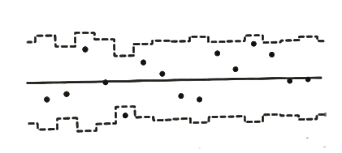
U Chart Example Number of HF Re-admissions / All Cause Re-admissions
HF readmissions / 1000 all cause readmissions

Slide 11
P Chart
Definition:
used with attribute data, classification (either/or, pass/fail), equal or unequal subgroup size, expressed as a percent
Advantages
Subgroups may be equal or unequal
Disadvantages
Requires calculation of subgroup size and limits
Useful for % / rate of occurrence of events
Minimum subgroup size must be met for chart to be effective
No more than 25% of subgroups w/ p = 0

Slide 12
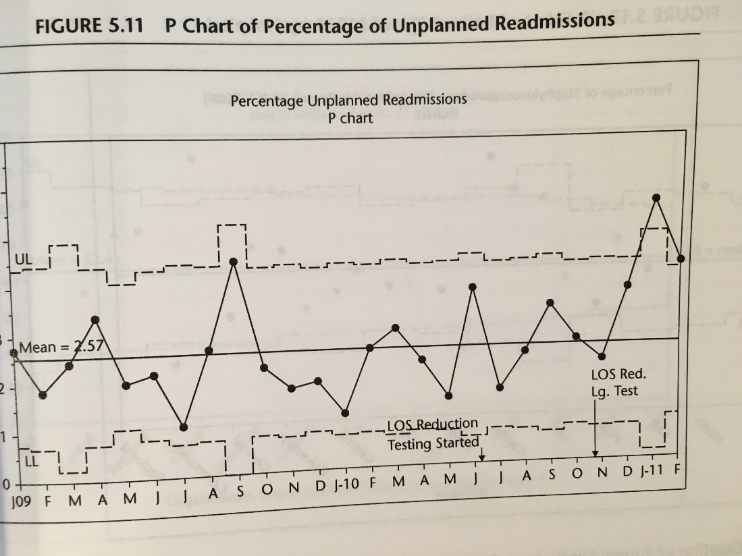
P Chart Example: % HF admissions with quantification of documented ventricular function
% HF admissions with documented LVEF assessment at discharge

Slide 13
I chart
Advantages
Flexible for un-group-able data
Disadvantages
No ability to use subgroups to see source of variation
No calculations required to plot data on chart
Immediate feedback; plotting done w/ each measure
Easy to put multiple measures on one chart
Capability of a process can be evaluated directly
All sources of variation combined on one chart
Not sensitive to non-symmetric distribution of data (may require data transformation)
Definition:
(X chart or Xmr chart)—used with continuous data, single data value for each subgroup, subgroup size is one

Slide 14
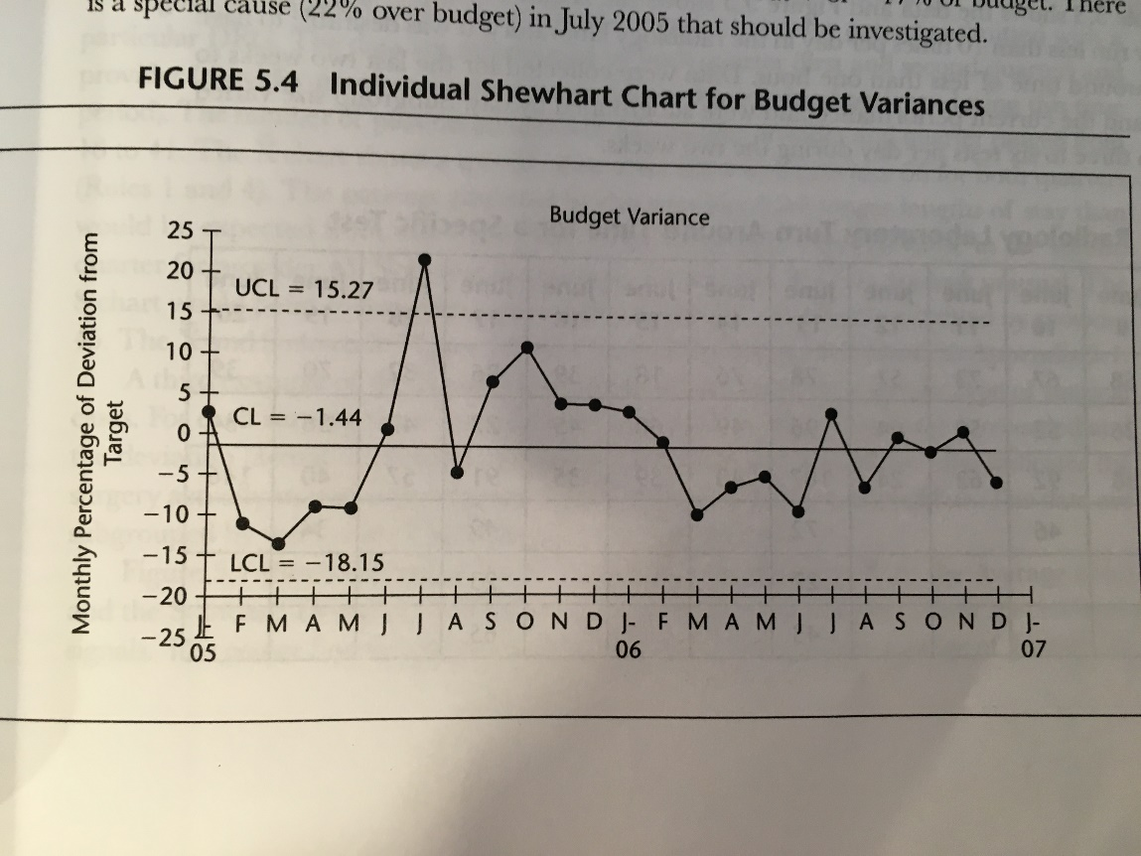
I Chart Example Number of HF Device Procedures Scheduled Per Week
Scheduled # of HF device procedures / month

Slide 15
X bar chart and S chart
Definition:
Used with continuous data, subgroups have more than one data value, equal or unequal subgroup size
Advantages
Flexible for equal or unequal subgroups
Disadvantages
Requires subgroups measured in same time period or conditions
Shows both avg (mean) performance and variation about the mean (standard deviation)
Subgroup size can be small or large
Limits will vary; calculation is complex and requires software

Slide 16
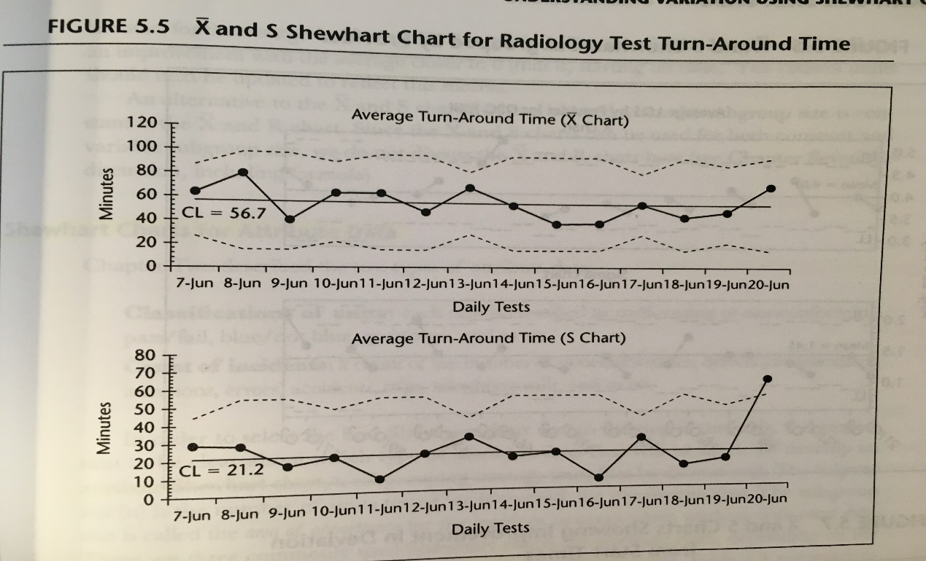
X bar and S Chart Example Number of Patients Seen Per Hour by Provider in Clinic
# of patients seen / hour by provider in the HF clinic

Slide 17
What’s Next: Ongoing Monitoring Over Time
Measurement
Where are we?
Evaluation
Where we planned to be?
Correction
How can we get on track again?

Slide 18
Summary
The correct type of control chart depends on the type of data
5 types of control charts include:
C, U, and P Charts use counts and classification data
I, and “X and S” Charts use continuous data
Two common mistakes in chart selection include:
Treating attribute data (expressed as % or rate) as continuous
Treating continuous counts (census, volume of visits or labs) as attribute

