Slide 1
Module 5 Part 3 Understanding System Stability: Types and Causes of Process Variation
Adapted from:
The Institute for Healthcare Improvement (IHI), the Agency for Healthcare Research and Quality (AHRQ), and the Health Resources and Services Administration (HRSA) Quality Toolkits

Slide 2
Objectives
Describe system stability using baseline data
Identify types and causes of variation in system processes
Identify if a change is needed, and where?

Slide 3
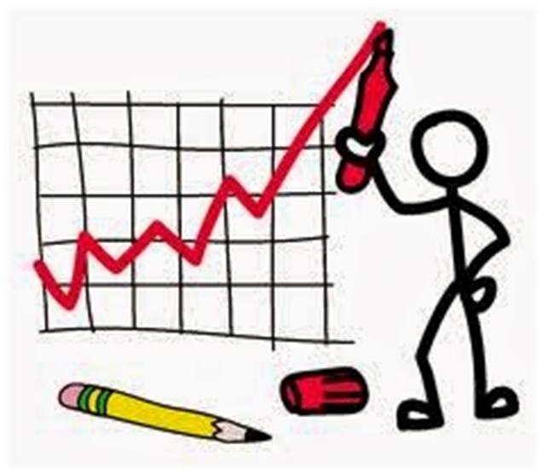
Using Baseline Data to Assess System Stability

Slide 4
Goal of Measuring Health System Performance
Is Performance Stable?
Improve Quality Outcomes Performance
Dimensions of System Performance
Outcomes | IOM “STEEP” metrics: safe, timely, effective, efficient, equitable, person-centered
Transaction | Volume, number of patients with event
Productivity | Cycle time, efficiency, utilization, flow, capacity, demand
Cost | Charges, staff hours, materials and resources used
Appropriateness | Validity, usefulness
Patient Satisfaction | Surveys of complaints and commendations
Culture / Staff Satisfaction | Surveys; Rates of absenteeism, turnover

Slide 5
Design a Report of Baseline Data

Slide 6
Presenting Data in a Meaningful Way (Charts)
Charts provide a visual display of data
Used to convey meaning often hidden in a table or text
Different kinds of charts are useful for improvement data:
.Run charts
Control charts
Data visualization (snapshot or dashboard) charts

Slide 7
Run Charts
Linear graphs
Data points are displayed over time
Time is displayed on horizontal (x) axis
Variable is displayed on vertical (y) axis
Run charts show improvement patterns observed over time

Slide 8
Other Methods of Data Display
Chart selection depends on the purpose for data display
Commonly used options include:
Pareto charts
Frequency charts - pies, bars, and box plots
Distribution charts – box and scatter plots
Charts used to visually represent snapshots of data:
Depicting the current state of a clinical setting or process
For example, displaying the age of patient population

Slide 9
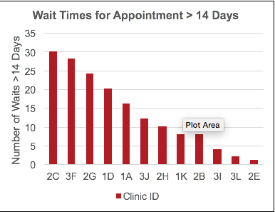
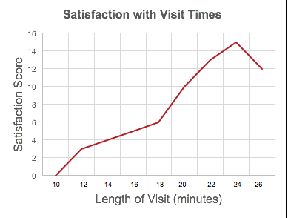
Review Baseline Data on the Family of Measures

Slide 10
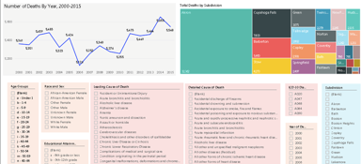
Dashboard Reports
Presents at-a-glance information on each measure
Presents data in summary form, to identify key trends
Provides an overview of the current state of data and processes
Does not show detailed information on causes or solutions
Examples of data that can be displayed in dashboard reports include:
financial indicators (days of ICU stay)
patient satisfaction indicators (average length of wait time)
clinical indicators (# of patients with A1c or blood pressure measures)
provider performance indicators (compliance with clinical standards).

Slide 11
Purpose of Visual Display
Understanding Baseline Data Variation
Select the family of measures relative to the AIM
Plot variation in the family of measures using a run chart series
Assess the variability in the system
Do data vary?
Do data vary over time for all subgroups?
Do data vary within or between subgroups?
Assess the types and causes of variability in the system
Answer the Question: Is the current system stable?

Slide 12
Assess the Presence and Types of Variation
What does the concept of variation mean?
How do data “vary”?
Intended variation is purposeful
Weight-based medication dosing
Health literacy based patient education
Unintended variation is not purposeful
Medication delivery times
“Discharge readiness” scores

Slide 13
Assess the Cause of Variation
Why do data “vary”?
Common cause: result of a defect in the system
Stable system but undesirable outcomes
PDSA – change system to improve; remove variation
Special cause: result of outside influences
Unstable system – either desirable or undesirable
Identify the cause
Learn from the data
Take action

Slide 14
Special Cause versus Common Cause Variation

Slide 15
Criteria for Determining Special Cause Variation
Any data point falling outside the upper or lower control limits
Two of three consecutive points near a control limit line
Shifts of ≧ 8 points in a row above or below the centerline (mean)
≧ 6 consecutive points increasing or decreasing
15 consecutive points in the inner one-third section of the chart

Slide 16
Select a Key Measure Related to the Aim
Develop Appropriate Shewhart Chart
2. Select Chart Type
Type of data = Type of chart
P, C, U, G, T, I, X-bar(S)
Assess baseline data / graphics
Get 12 points (trial) or 20
Set median / control limits
Assess subgrp variability
Assess histogram
1. Assess Data- Key Measure
Type of data (level of measure)
Subgroup size & variability
Metric used (rate or %)
Time interval
Is the System Stable?
Identify Common Cause
Fluctuation cause is unknown
Steady but random distribution of output around the mean
A measure of process potential; how well process can perform if special cause is removed
Tools / Methods:
Planned experiment
Rational subgrouping
YES
NO
Identify Special Cause
Data points outside control limits
In zones A, B or C (>3 SD of M)
Tools / Methods:
Shewhart charts
Cause-Effect diagram
Planned experiment
Rational subgrouping

Slide 17
Summary
Variation is a concept that reflects stability of a system
Types of variation include:
Intended
Unintended
Visual tools (charts and graphs) help identify variability in a system
Causes of variation include:
Special cause
Common cause

