Slide 1
Module 3 Part 3 Developing and Implementing a QI Plan: Tools and Techniques
Adapted from:
The Health Resources and Services Administration (HRSA) Quality Toolkit

Slide 2
Learning Objectives Module 3: QI Tools and Techniques
Review tools needed for improvement work

Slide 3
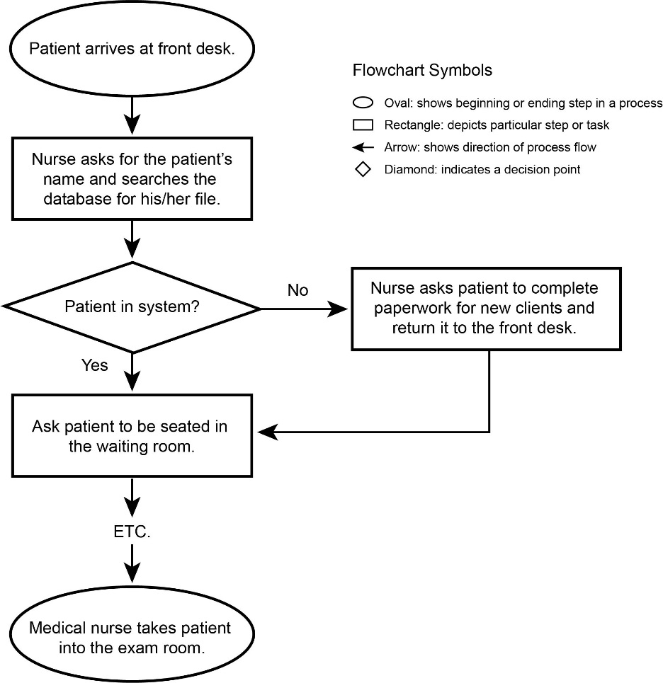
Flow Chart
Used to identify the actual flow or sequence of events in a process
Used in early stage of a QI project to help team members gain a better understanding of how processes are actually happening
Once problems are identified, a second flow chart can be created to show how a process should be performed
Source: HIVQUAL Group Learning Guide. New York State Department of Health AIDS Institute.

Slide 4
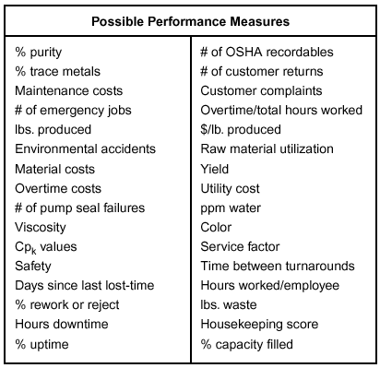
Brainstorming
Used to generate a large number of ideas for:
Issues to tackle
Possible causes
Approaches to use
Actions to take through the interaction of a group of people
Bringing out ideas in a group setting to find possible solutions and causes for a problem/issue

Slide 5
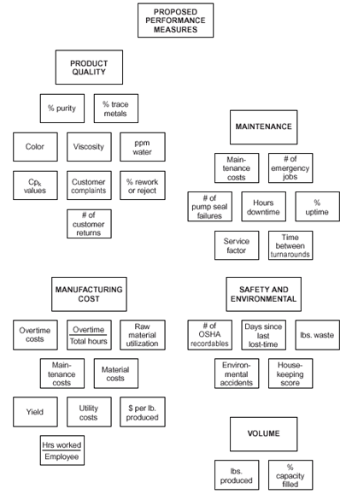
Affinity Diagram
Is used to gather large number of ideas, issues or opinions
Organizes them into groupings based on their natural relationship
You can use this tool to group ideas generated by brainstorming with your team and to sift through large volumes of data/information
Source: American Society for Quality

Slide 6
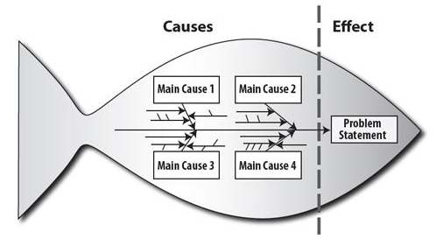
Cause and Effect/Fishbone
Diagram/Ishikawa is used to identify and graphically display all possible causes of a certain effect
This tool helps team members to think in a systematic way and understand a problem and all the factors /root causes associated with the problem/cause/effect
Source: Quality Improvement: Guide for HIV/AIDS Clinical Care. AETC National Resource Center.

Slide 7
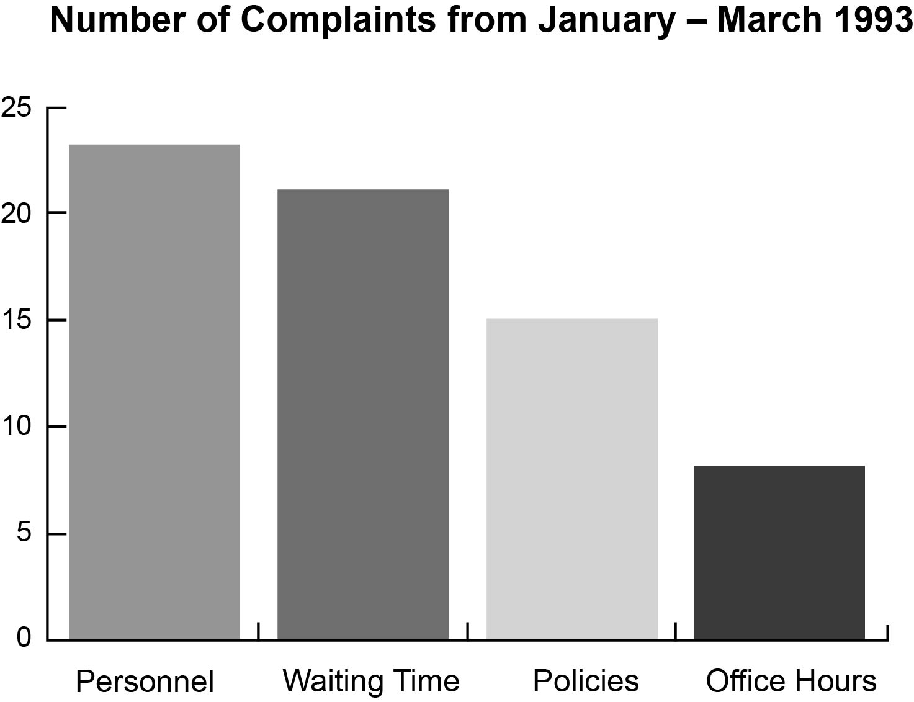
Histogram
Is a bar chart used to recognize and analyze patterns in a large set of data that are not apparent simply by looking at a table of data, or by finding the average or median

Slide 8
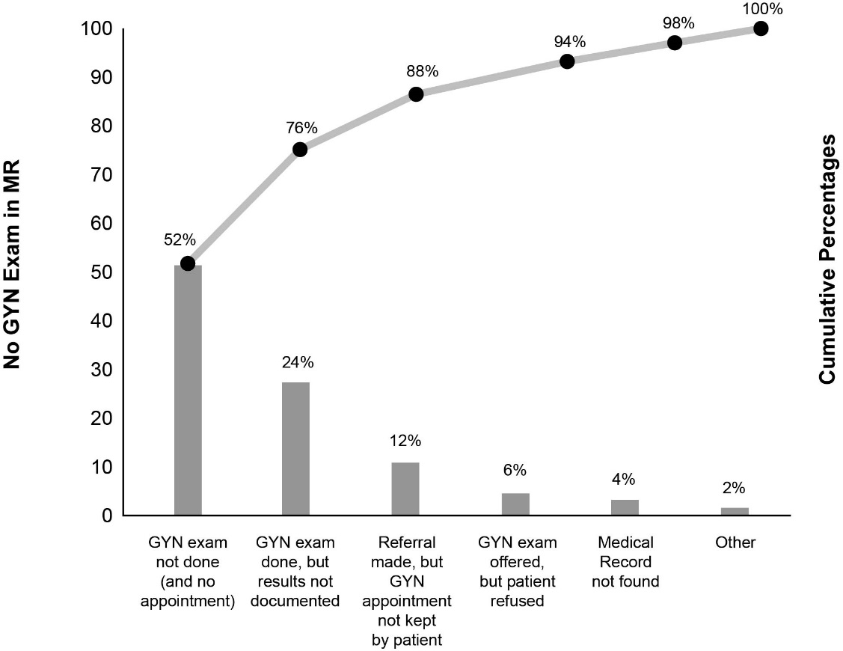
Pareto Chart
Used to display categories of problems graphically so they can be properly prioritized
Used when communicating to others about your data
Used when analyzing data about the frequency of problems or causes in a process or when there are many problems or causes and you want to focus on the most significant problem
Source: HVQUAL Group Learning Guide. New York State Department of Health AIDS Institute.

Slide 9
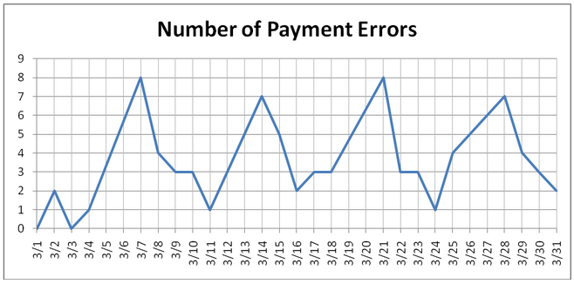
Run Chart
Used to study observed data (a performance measure of a process) for trends and patterns over a specified period of time
Helps to see changes in performance over time and understand variation in process performance
Used to report data to senior staff or team members

Slide 10
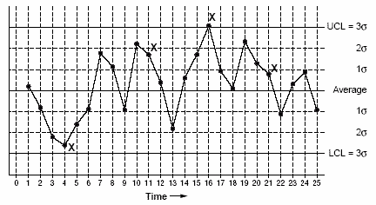
Control Chart
Used to monitor, control, and improve process performance over time by studying variation and its source
Used to study how a process changes over time
Data are plotted in time order
Has a central line for the average, an upper line for the upper control limit (UCL) and a lower line for the lower control limit (LCL)
Used to identify opportunities to improve performance or measure the effectiveness of a change in a process, procedure, or system

Slide 11
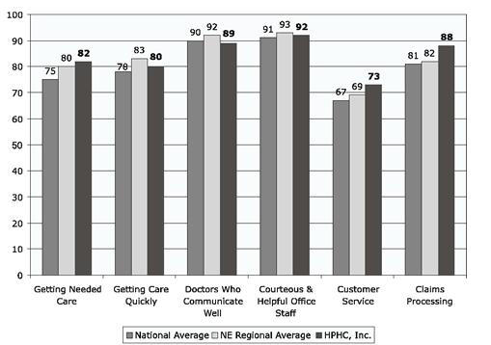
Benchmarking
Involves comparing characteristics of different entities for the purpose of understanding the performance of other similar organizations and improving one’s own performance
Enables entities to improve their position competitively by helping clarify consumer needs and modern technologies and/or processes necessary to meet those needs
HPHC Performance on CAHPS Composites Compared with National and Regional Averages

Slide 12
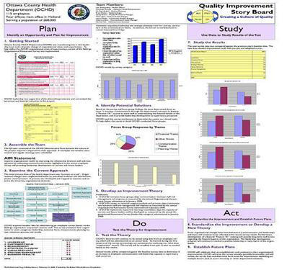
Storyboard
Is a useful communication tool for effectively presenting a team’s work to a variety of audiences

Slide 13
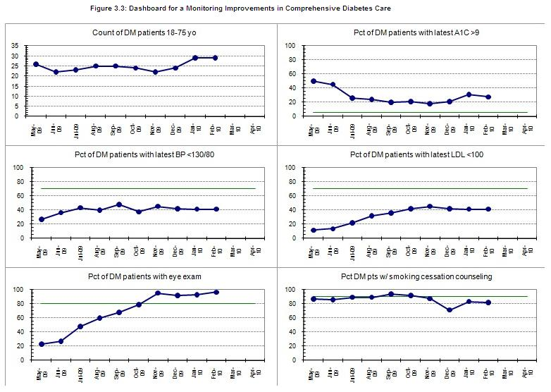
Dashboard
Dashboard for a Monitoring Improvements in Comprehensive Diabetes Care
Is a visual tool that highlights an organization’s performance in a number of designated areas of quality
It includes response actions and desired changes in system, education, and compliance/competency behaviors, etc.
Source: Managing Data for Performance Improvement: Dashboard for Monitoring Improvements in Comprehensive Care. Health Resources and Services Administration.

Slide 14
Summary
There are many tools available to help facilitate change and help QI efforts.
Choose tools and charts that will represent needed metrics

