Slide 1
Module 1
Overview of Improvement Science

Slide 2
Learning Objectives Module 1
Discuss “Improvement Science” and “Quality Improvement”
Review methodologies for QI:
PDSA
Six Sigma (DMAIC)
Lean

Slide 3
What is Quality Improvement (QI)?
Quality improvement (QI) = Improvement Science (IS)
QI is measuring processes in health care services and associated change in the health status of targeted patient groups
The Institute of Medicine (IOM) defines quality in health care as a direct correlation between the level of improved health services and the desired health outcomes of individuals and populations
Notes:
Measurements and observations used to describe the health system outcomes, processes and patient experiences

Slide 4
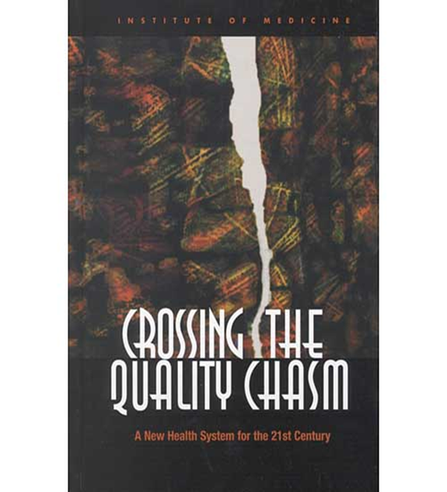
National Quality Definition
Six aims of quality
Safe
Timely
Effective
Efficient
Equitable
Patient-Centered
Right thing, right time, right way
Many stakeholders
Notes:
Benefits of a stable system:
Costs and quality are predicable
Productivity is at maximum and costs are minimum
Effect of change can be measured with greater speed and reliability
PDSA tests of change can be more efficiently used to identify changes that result in improvement
A stable process provides a good argument for altering specifications that can’t be met economically

Slide 5
Quality Who decides if quality is achieved?
National Quality Forum (NQF)
The Joint Commission (TJC)
Centers for Medicare and Medicaid Services (CMS)
Agency for Healthcare Research and Quality (AHRQ)
Specialty Registries (ACC, STS)
Moving from Pay to Participate to Pay for Performance
Notes:
Measurements and observations used to describe the health system outcomes, processes and patient experiences

Slide 6
Approaches in Healthcare
Improvement science (QI) evaluates cycles of local process change
PDSA
Six Sigma (DMAIC)
Lean
Implementation science tests effectiveness of QI against control
Randomization of site-based QI studies
Mixed methods (triangulation of quantitative and qualitative data to derive reasons for failure of defect free quality goal)
Other quasi-experimental designs
Notes:
Measurements and observations used to describe the health system outcomes, processes and patient experiences

Slide 7
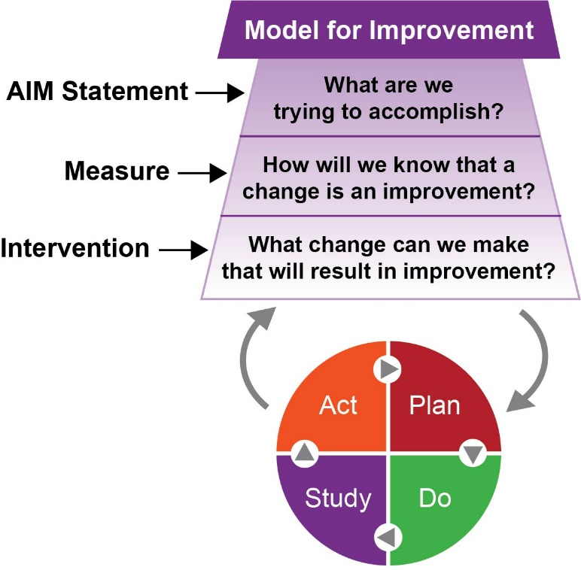
Science of Improvement How to Improve: The Model for Improvement
The model has two parts:
Three fundamental questions
Can be addressed in any order
The Plan-Do-Study-Act (PDSA) cycle
Notes:
Benefits of a stable system:
Costs and quality are predicable
Productivity is at maximum and costs are minimum
Effect of change can be measured with greater speed and reliability
PDSA tests of change can be more efficiently used to identify changes that result in improvement
A stable process provides a good argument for altering specifications that can’t be met economically

Slide 8
Six Sigma Approach
Notes:
Measurements and observations used to describe the health system outcomes, processes and patient experiences

Slide 9
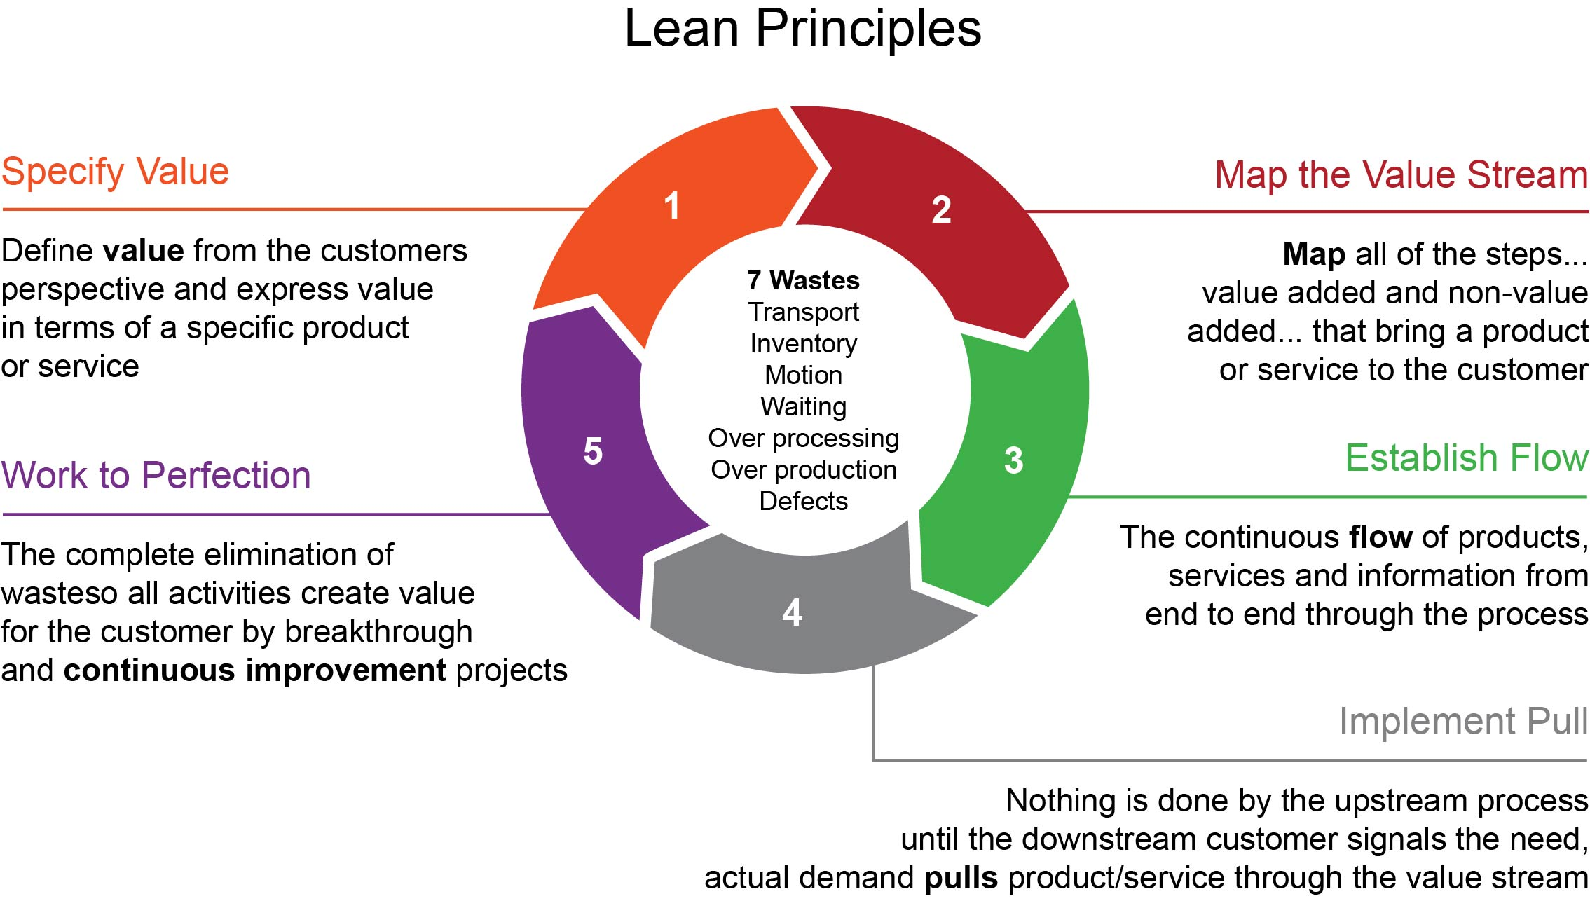

Slide 10
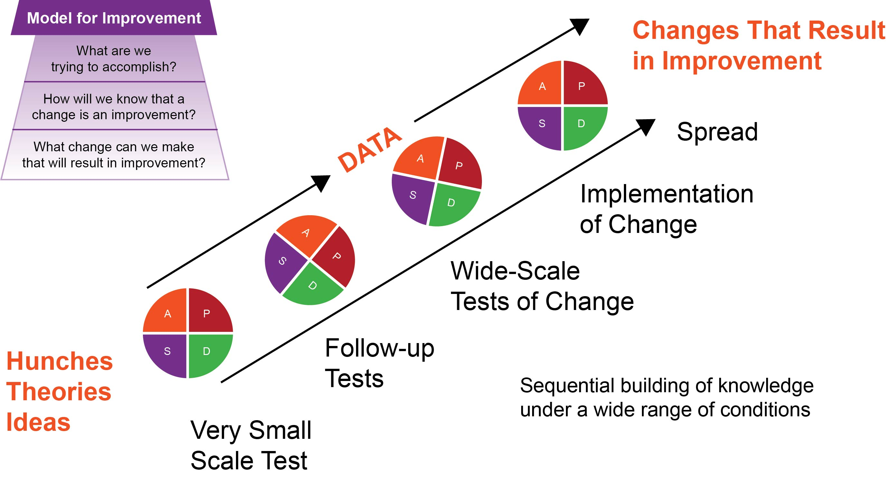

Slide 11
Quality Measurement Plots Data Over Time
http://www.ihi.org/resources/Pages/HowtoImprove/ScienceofImprovementEstablishingMeasures.aspx

Slide 12
Scorecards combine performance monitoring with targets

Slide 13
Summary
QI is needed for improvement in healthcare services and the health status of targeted patient groups
The aims of quality address improvement:
Right thing, right time, right way
Use a model to guide improvement efforts
Recognize measurement challenges to plan for the highest quality data possible
Shewhart, 1931
Deming, 1986
Notes:
Benefits of a stable system:
Costs and quality are predicable
Productivity is at maximum and costs are minimum
Effect of change can be measured with greater speed and reliability
PDSA tests of change can be more efficiently used to identify changes that result in improvement
A stable process provides a good argument for altering specifications that can’t be met economically

