Slide 1
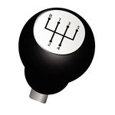
STEMI Accelerator
Regional Systems of Care Demonstration Project
SUSTAIN Acceleration Discharge and Follow-Up
Lisa Monk MSN, RN, CPHQ
December 6, 2016

Slide 2
Objectives
Review data tracker example (excel file)
Discuss the sections and how to answer the questions
Review the steps to score the section both possible score and actual score

Slide 3
Criteria
STEMI
Had an intervention with a stent
Begin with October Discharges
Last patient in will be December 31, 2017 and final data collection will be 11 months later – November, 2018

Slide 4
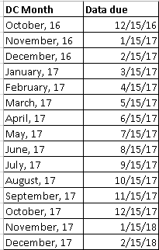
Data due Dates
Submit each month on the 15th day
6 weeks after the 30th day of the month
For example: January patients are due March 15
First data submission due
December 15

Slide 5
9 sections
Demographics
Med Rec At Discharge
Readmission rate
Written Patient Goals
Written Discharge Plan
Follow up 48 hours
7 day visit
30 day Readmission
11 month follow up

Slide 6
Sections
Demographic Info
Do not report identifiers when submitting this form
Recommend keeping a separate key so you know which patients are which for follow up
Next 4 sections (Med Rec, Readmission Risk Rate, Pt. Goals, Discharge Plan)
need to be answered and scored
Not applicable – when it doesn’t apply
Unknown-please use this cautiously

Slide 7
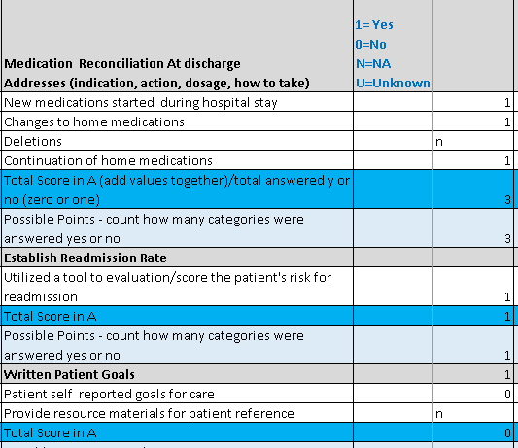
Scoring
The following sections are scored:
Med Rec
Readmission Rate
Pt Goals
DC Plan
Yes answers = 1 point
No answers = 0 points
NA/Ukn not counted in scoring
Answer the questions, add the scores for each section, carry this score to the total scoring section

Slide 8
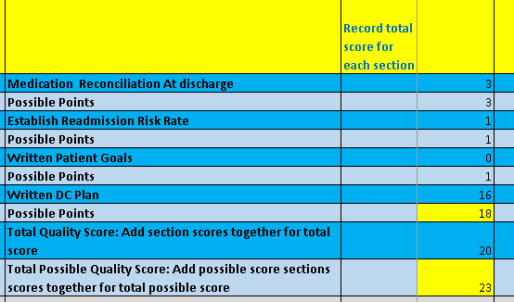
Record each section score here

Slide 9
Looking back at each section, count how many of the questions you answered yes or no
Record this count in the possible points section
3 question in Med Rec section were answered, one was na-record 3

Slide 10
Last 4 sections
Call Back
Come Back
Readmission at 30 days
Touch Back 11 months
Answer the questions
No scoring here

Slide 11
Summary
STEMI pts with stent beginning with October discharges and ending with December, 31, 2017
Complete data tracker and turn in 6 weeks after the last day of the month
Score tracker for possible and actual scores
Use unknown cautiously- only if truly unknown and not actually no
Hang in there, in a few months the time will decrease for you to abstract these chats.
Thank you for your efforts.

