Slide 1
The Drag & Drop Pillbox: Patient-Centered, Skill-Based Medication Management
Notes:
I think you know the rest!!!

Slide 2
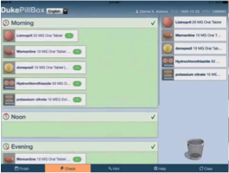
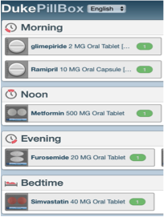
Digital Drag and Drop Pillbox

Slide 4
